Slide 1
Neural Network Time Series Forecasting of Finite-Element Mesh Adaptation
Akram Bitar and Larry Manevitz
Department of Computer Science
University of Haifa
&
Dan Givoli
Faculty of Aerospace Engineering
Technion - Israel Institute of Technology
Notes:
A. Bitar

Slide 2
Content
Introduction to Finite Element Method
Time Dependent Partial Differential Equations
The Finite Element Mesh Adaptation Problem
Introduction to Neural Networks
Time Series Prediction with Neural Networks
Our Method For Solving The Mesh Adaptation Problem
Notes:
A. Bitar

Slide 3
Finite Element Method (FEM)
What is it ?
  The most effective numerical techniques for solving various problems arising from mathematical physics and engineering
  The widely used numerical techniques for solving partial differential equations (PDEs)
Notes:
A. Bitar

Slide 4
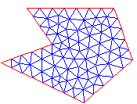
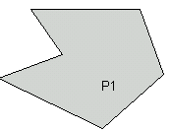
Finite Element Method (FEM)
  Divides up the PDE’s domain into finite number of elements
How does it work?
  Finds simple approximation on each element such that:
    Consistent with initial boundary conditions
    Consistent with neighboring elements
FEM Mesh
  Solution found by linear algebra techniques
Notes:
A. Bitar

Slide 5
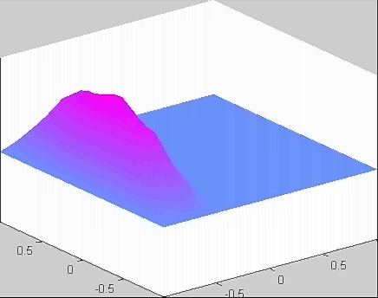
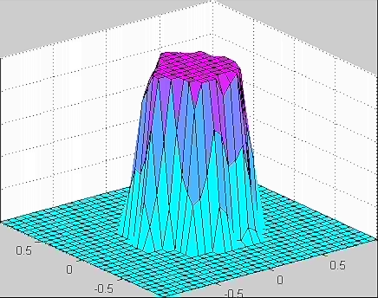
Time Dependent Partial Differential Equations
Hyperbolic
  Wave Equations
Parabolic
  Heat Equations

Slide 6
FEM and Time Dependent PDEs
The time dependent PDEs are repeatedly solved for different constant times using the previous solution as start condition for the next one
The “areas of interest” are propagated through the FEM mesh
In order to achieve a good approximation the mesh should be dynamic and varying with time
Notes:
A. Bitar

Slide 7
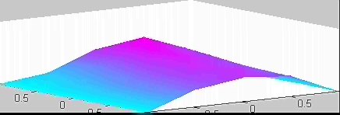
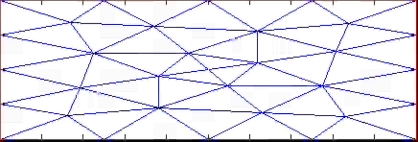
FEM and Time Dependent PDEs
For time dependent PDEs a critical regions should be subject to local mesh refinement.
The critical regions are identified by the regions, which their local gradient shows bigger changes.
Notes:
A. Bitar

Slide 8
Mesh Adaptations Problem
In current usage, the method is to use indicators (e.g. gradients) from the solution at the current time to identify where the mesh should be refined at the next time.
The defect of this method that one is always operating one step behind (behind the “area of interest”)
Notes:
A. Bitar

Slide 9
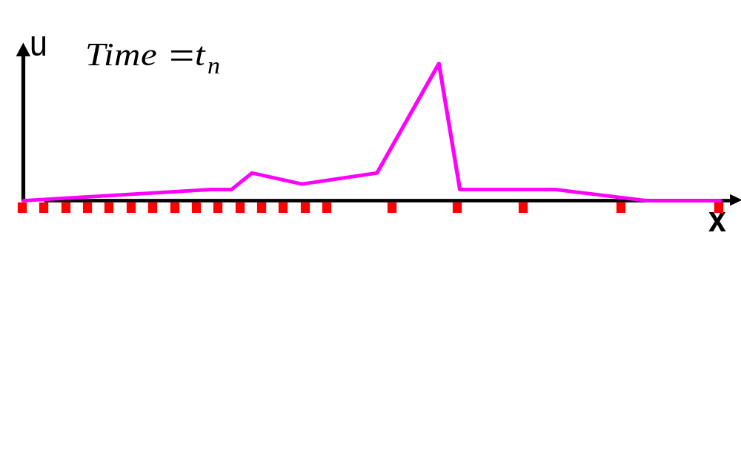
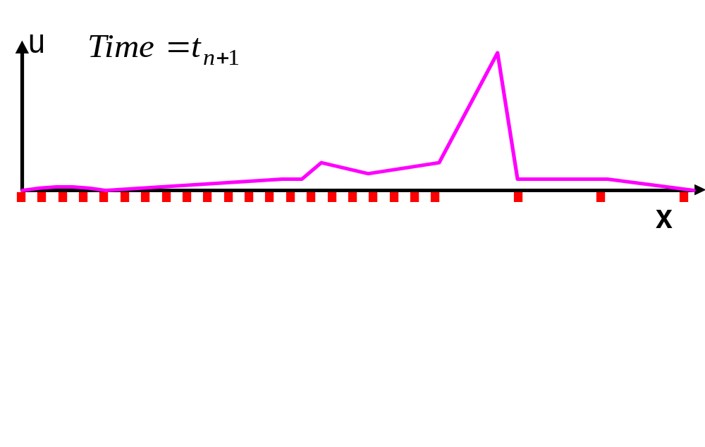
Mesh Adaptation Problem
Refine
We miss the action
Notes:
A. Bitar

Slide 10
Our Method
To predict the “area of interest” at the next time stage and refine the mesh accordingly
Time Series Prediction via Neural Network methodology is used in order to predict the “area of interest”
The Neural Network receives, as input, the gradient values at the recent time and predicts the gradient values at the next time stage
Notes:
A. Bitar

Slide 11
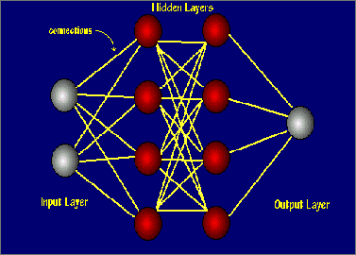
Neural Networks (NN)
What is it?
  A biologically inspired model, which tries to simulate the human nervous system
  Consists of elements (neurons) and connections between them (weights)
  Can be trained to perform complex functions (e.g. classifications) by adjusting the value of the weights.
Notes:
A. Bitar

Slide 12
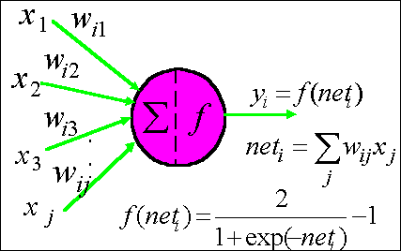
Neural Networks (NN)
How does it work?
  The input signal is multiplied by the weights, summed together and then processed by the neuron
  Updates the NN weights through training scheme (e.g. Back-Propagation algorithm)
Notes:
A. Bitar

Slide 13
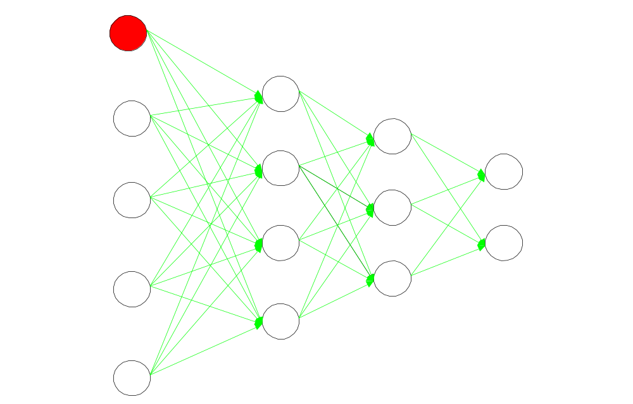
Feed-Forward Networks
Step 2: Feed the Input Signal forward
Train the net over an input set until a convergence occurs
Step1:
Initialize
Weights
Step3:
Compute the
Error Signal
(difference between the NN output and the desired Output)
Input Signals
Output Signals
Input Layer
Hidden Layers
Output Layer
Step4: Feed the Error Signal backward and update the waits
(in order to minimize the error)

Slide 14
Time Series Predicting Using NN
What is time series?
  A series of data where the past values in the series may influence the future values. (the future value is a nonlinear function of its past m values)
  The Neural Network can be used as a nonlinear model that can be trained to map past and future values of a time series
Notes:
A. Bitar

Slide 15
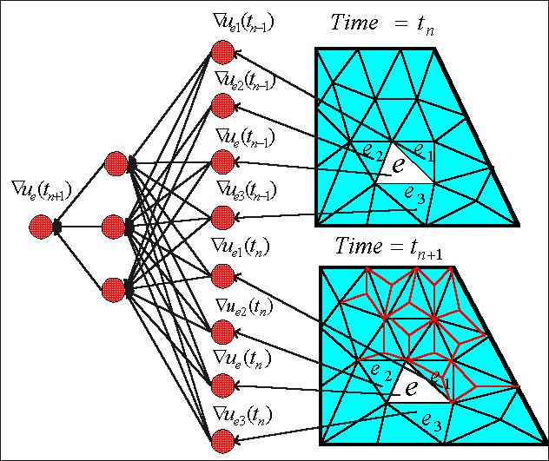
Applying NNs to Time Dependent PDES

Slide 16
Neural Network Architecture
Two networks
  One is for boundary elements and the other is for interior elements
Network input
  Eight input units (six for boundary element network), the gradient of the element and its neighbors in the current and previous times
Hidden Layers
  One hidden layer with six units
Network output
  One output unit, that gives the prediction of the gradient value at the next time stage

Slide 17
Training Phase
Training Set
  We calculate the solution on the initial nondynamic mesh over all the given time space
  We chose random examples (about 600) and trained the net over this set to predict the gradient
Training Performance
  For all the experiments that we did so far, the network training took at most 200 epochs to converge to an extremely small error
Notes:
A. Bitar

Slide 18
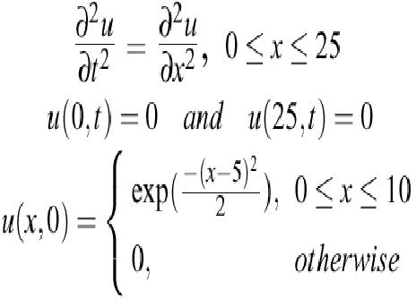
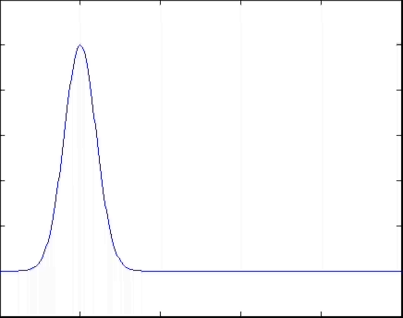
One Dimension Wave Equation
PDE
Analytic Solution

Slide 19
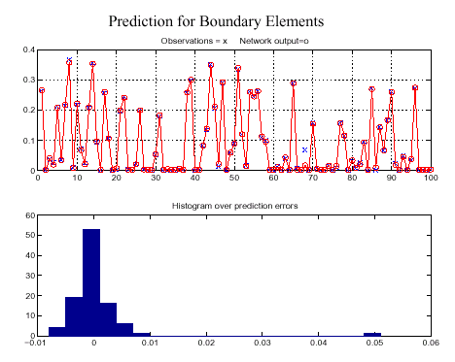

Slide 20
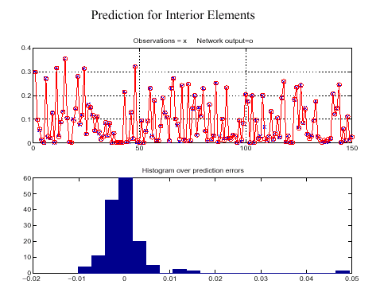
Notes:
A. Bitar

Slide 21
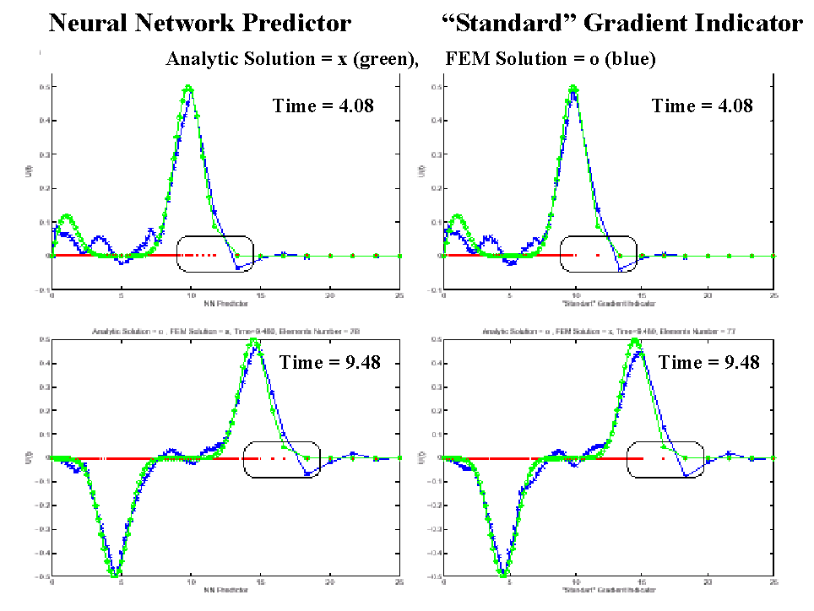

Slide 22
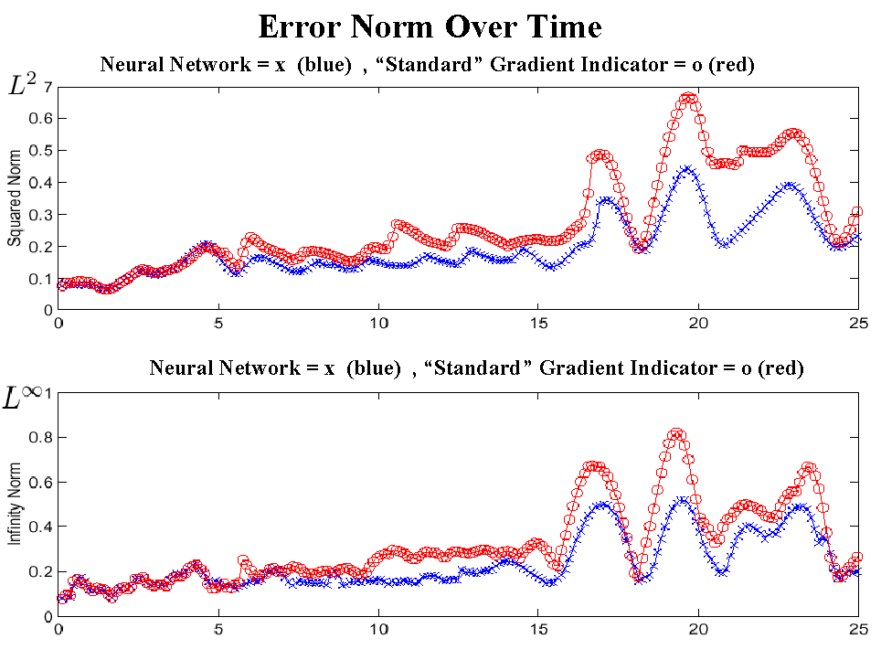
Notes:
A. Bitar

Slide 23
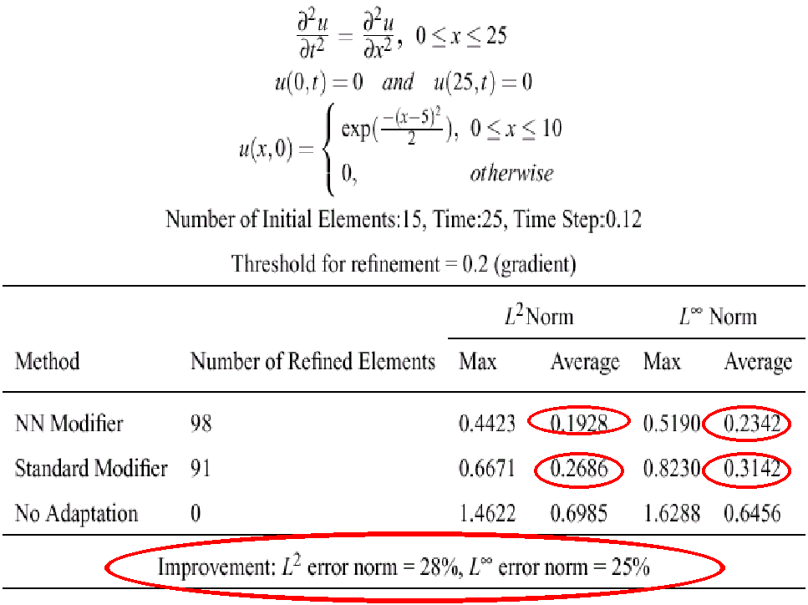

Slide 24
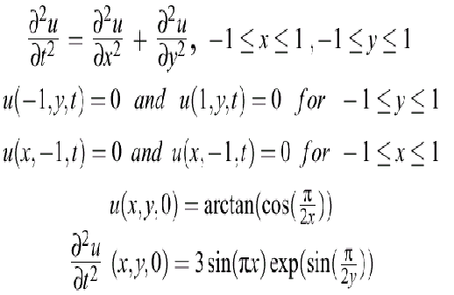
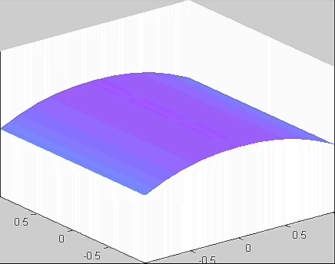
Two Dimension Wave Equation
PDE
Analytic Solution
Notes:
A. Bitar

Slide 25
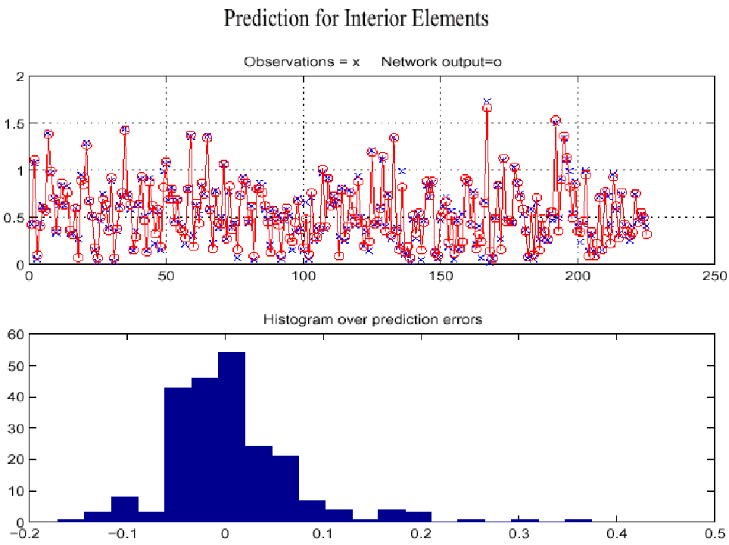

Slide 26
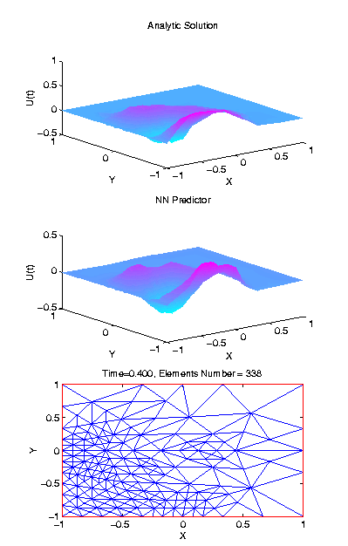
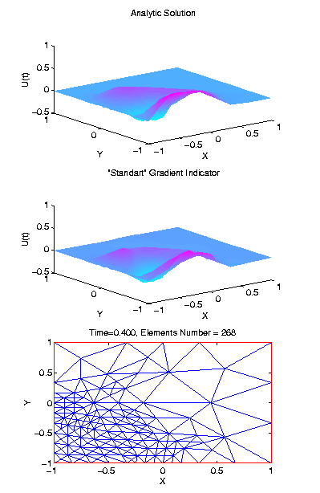
Neural Network Predictor
“Standard” Gradient Indicator
Analytic Solution
Analytic Solution
FEM Solution
FEM Solution
Time=0.4
Time=0.4

Slide 27
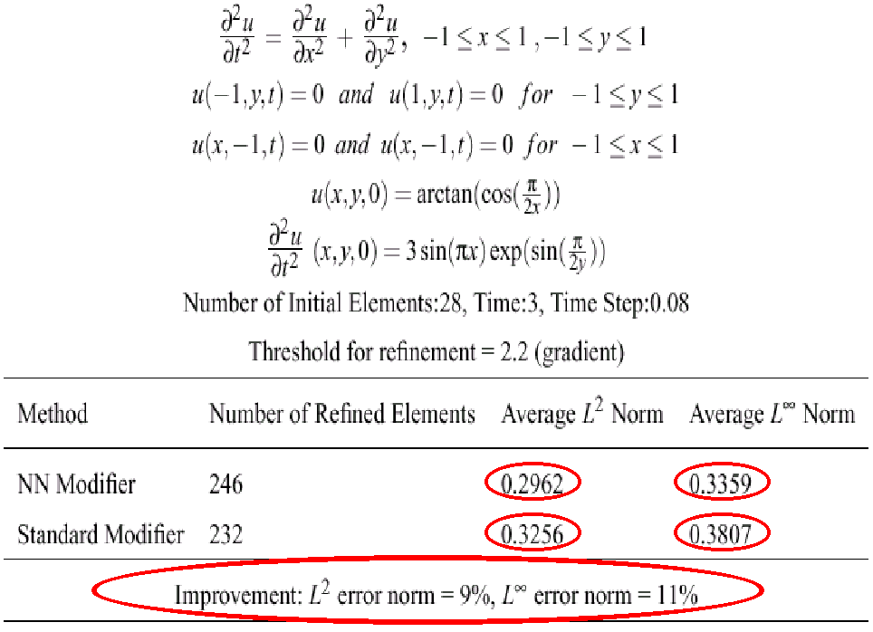

Slide 28
Summary
We have shown that the Time Series Prediction via Neural Network can accurately predict the gradient values
By applying the NN predictor we obtained a substantial numerical improvement over the current methods

